Slide 1
open source map making
jden.us/open-source-map-making

Slide 2
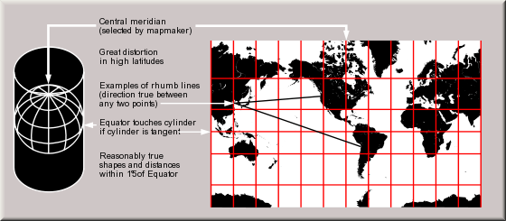
Projection

Slide 3
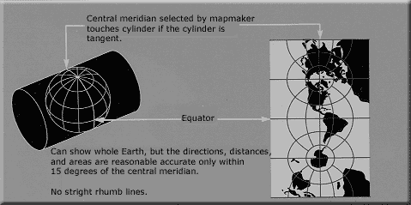

Slide 4
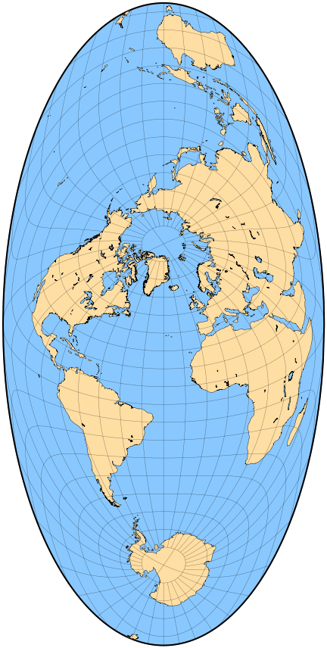

Slide 5
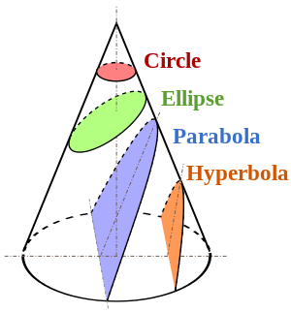
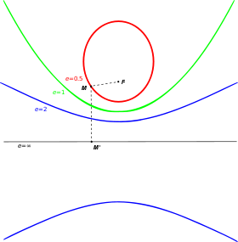

Slide 6
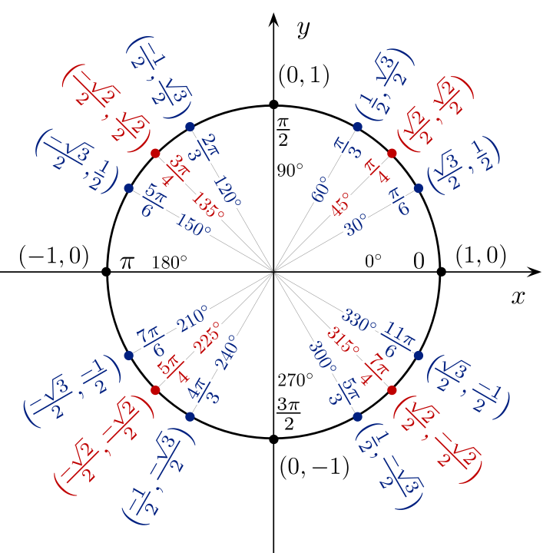

Coordinate Reference System (CRS)

Slide 7
We’re gonna make it easy:
Projection = Web Mercator
CRS = WGS84 (aka GPS coordinates)

Slide 8
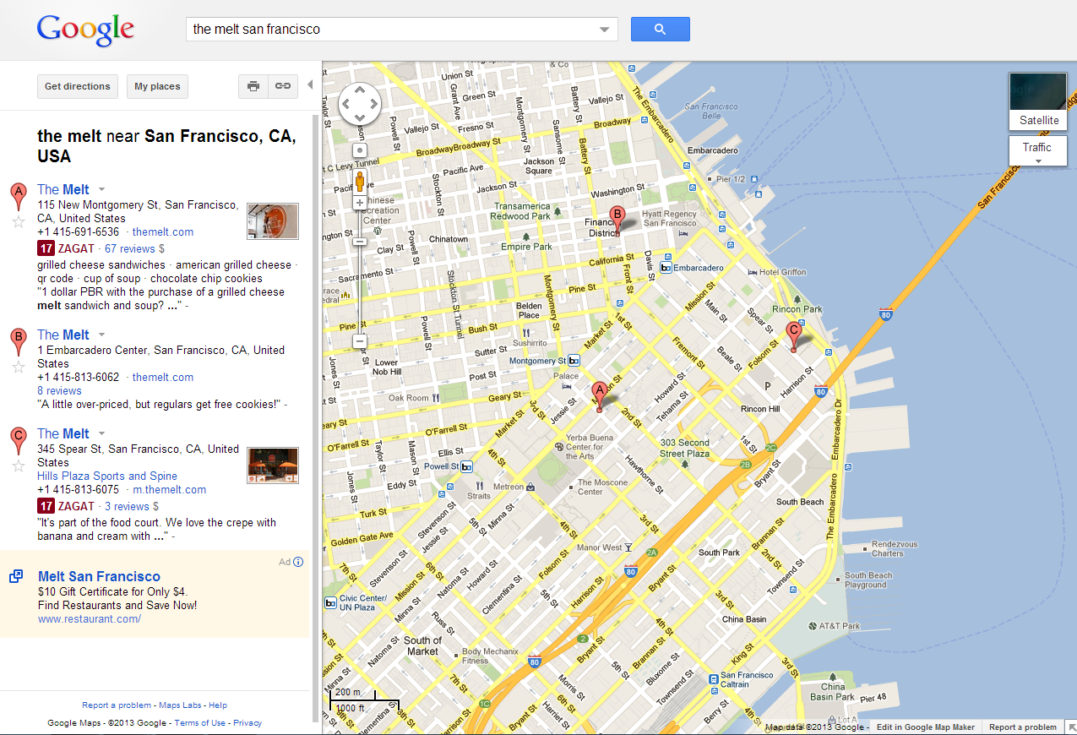
Technical term: “slippy map”

Slide 9


Slide 10
Cartography
How maps look

Slide 12
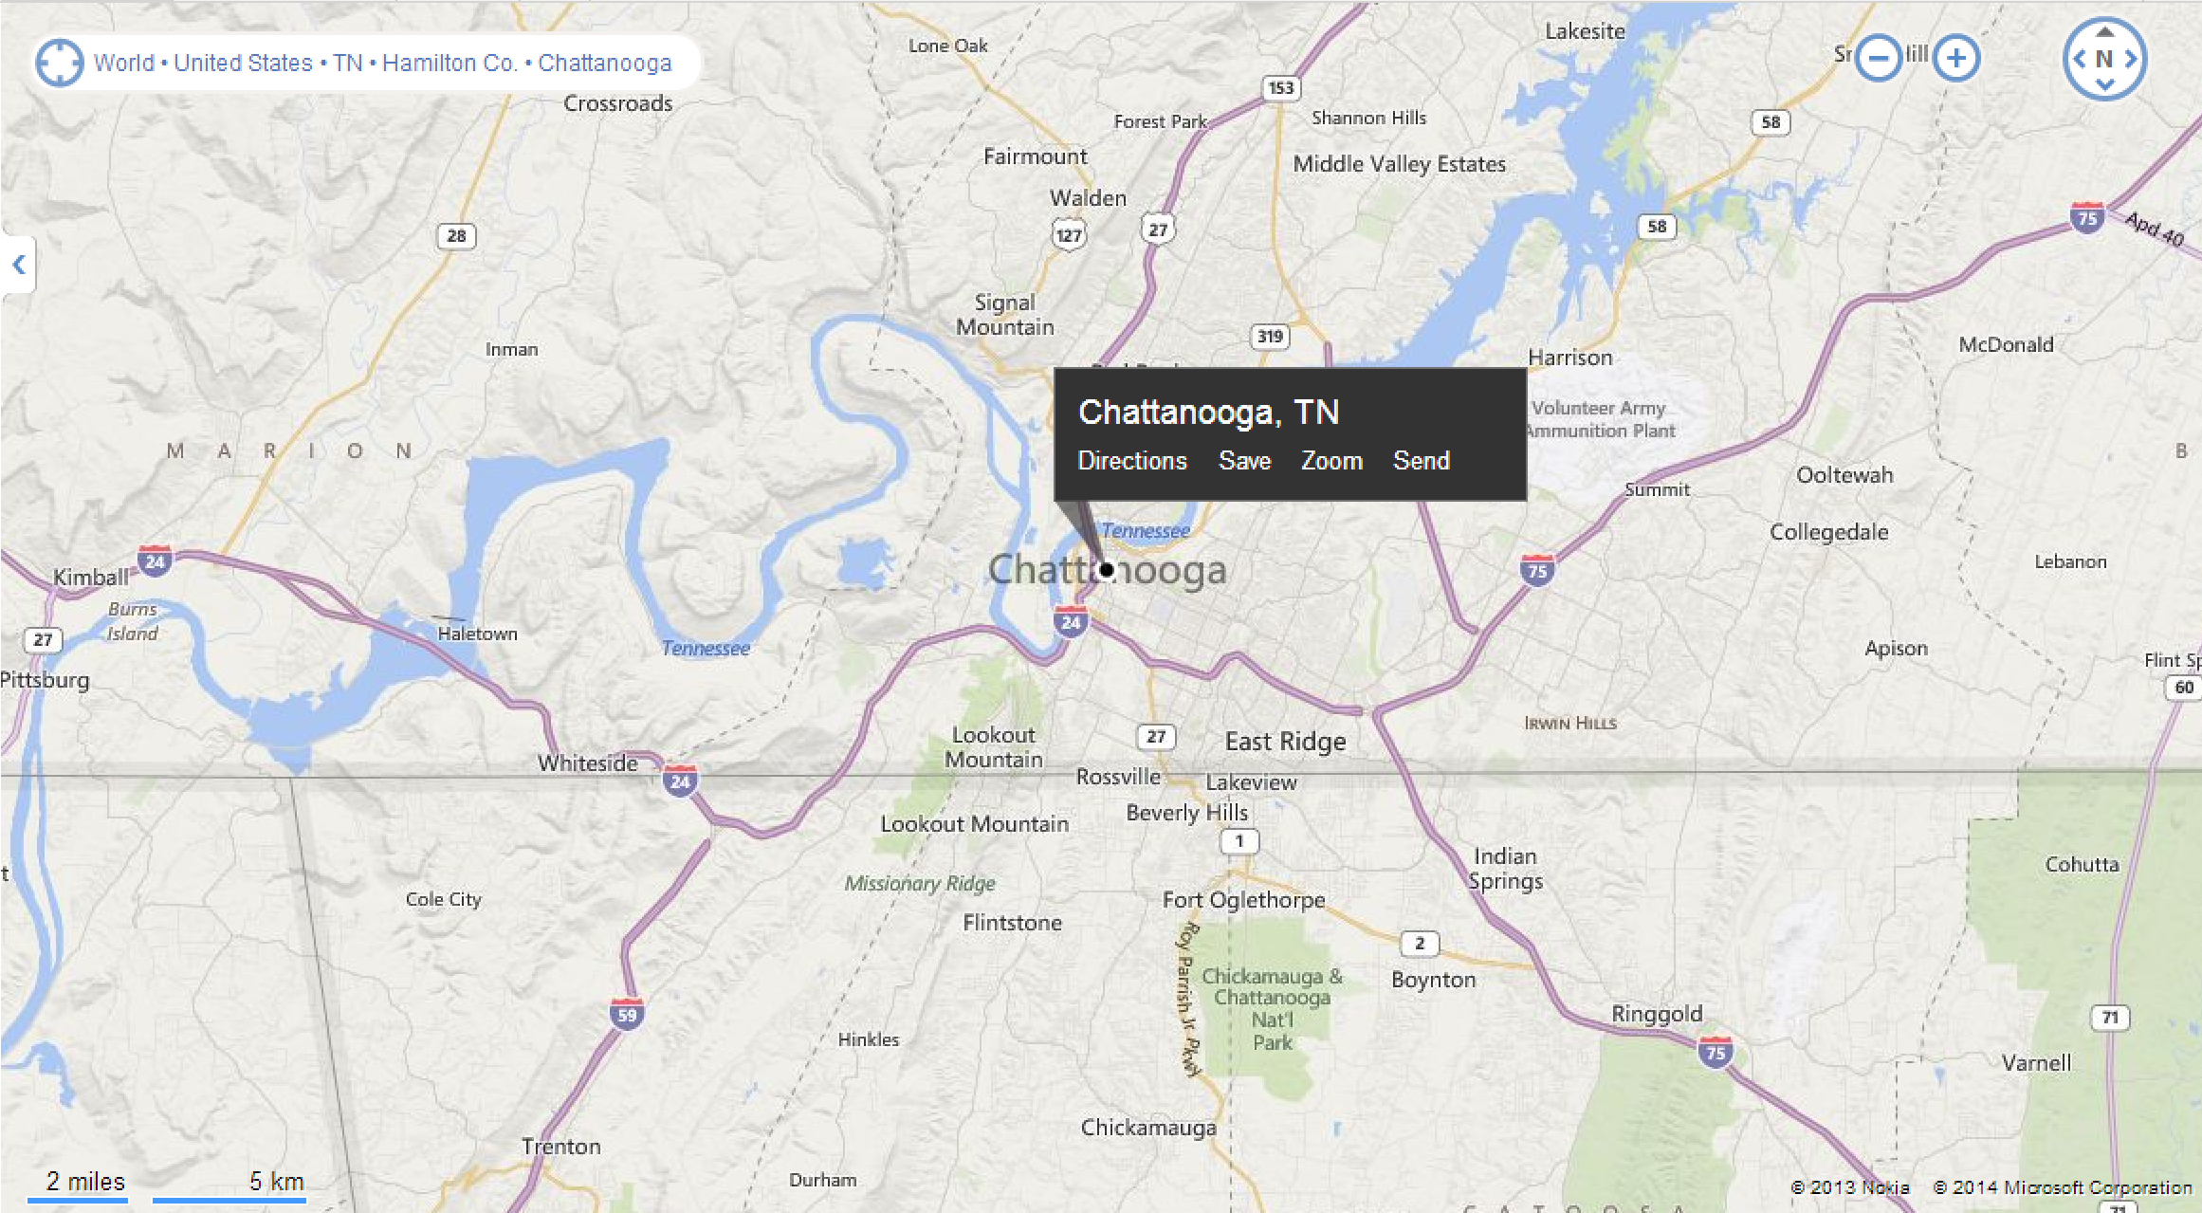

Slide 13
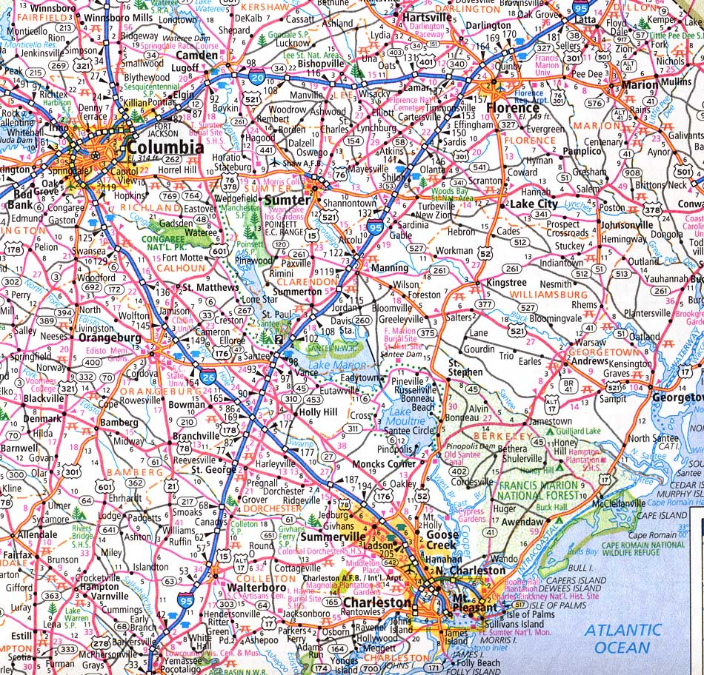

Slide 14
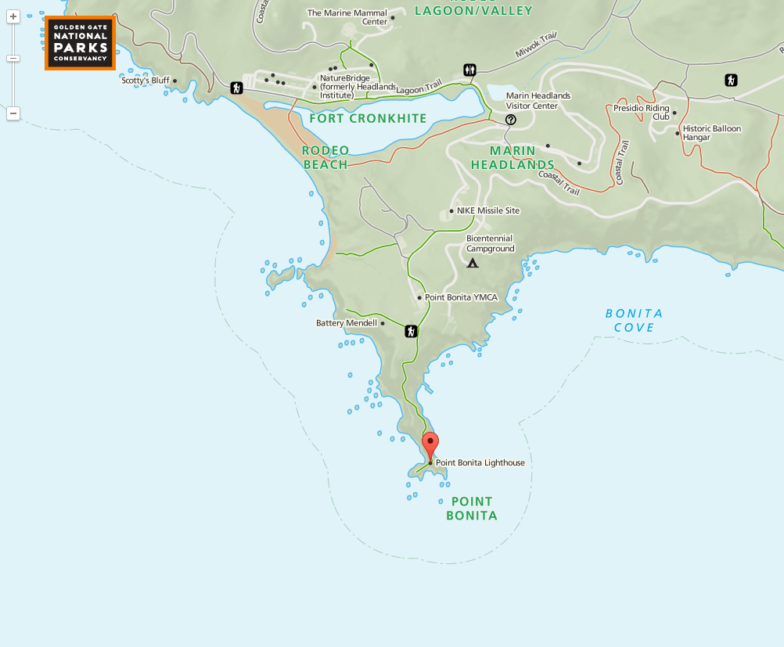

Slide 15
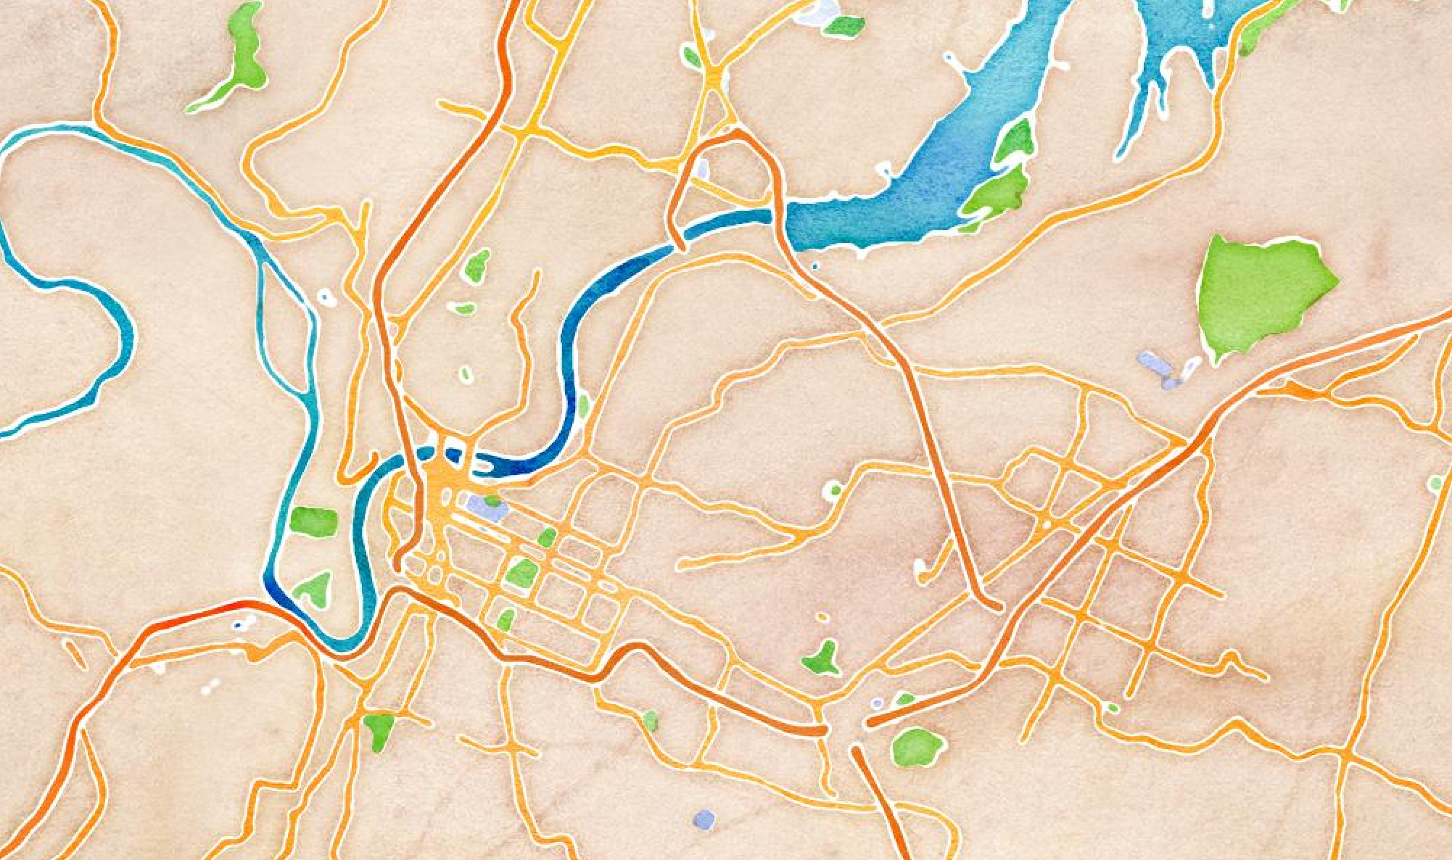

Slide 16
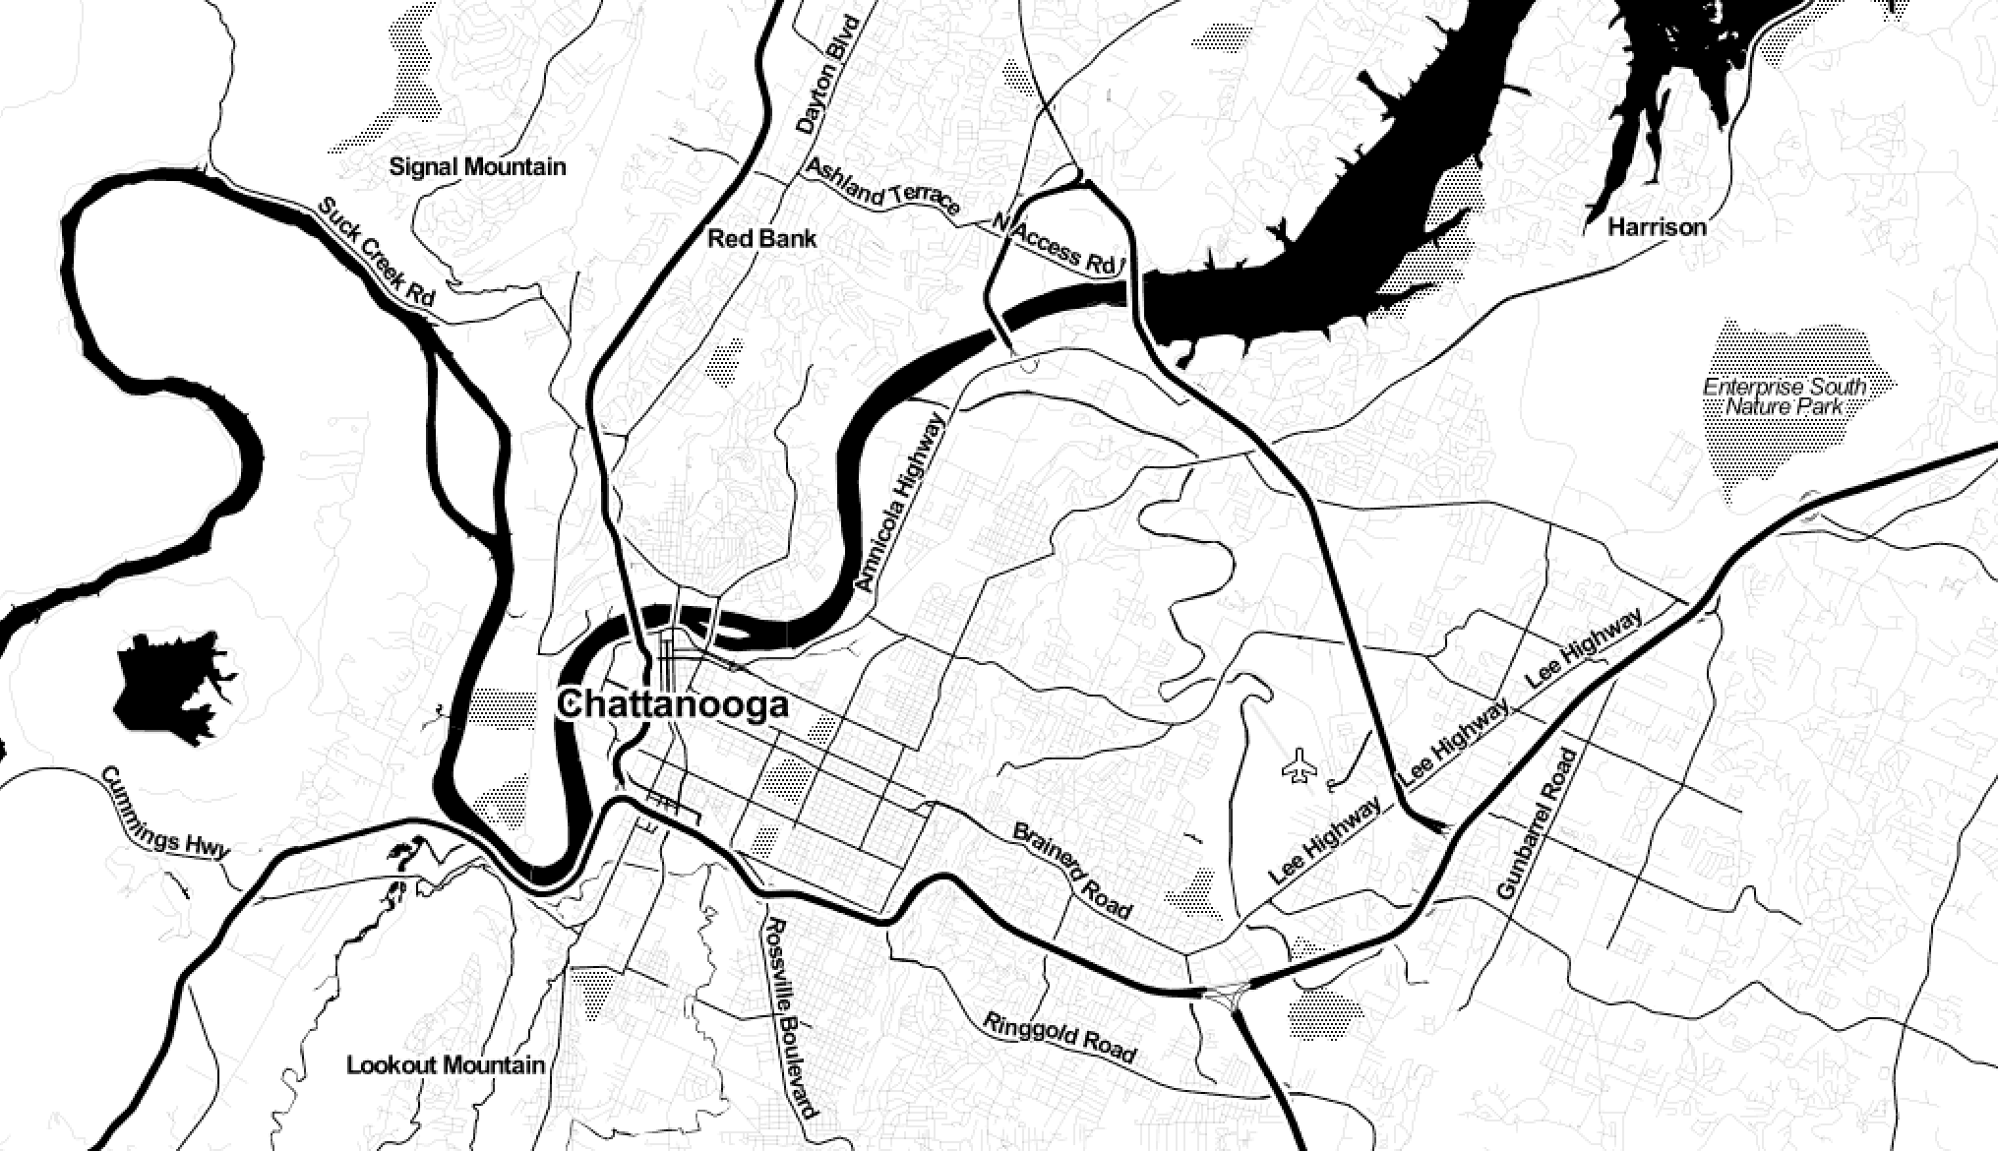

Slide 17
TileMill
https://www.mapbox.com/tilemill/

Slide 18
Leaflet.js
http://leafletjs.com/

Slide 19
GeoJSON
http://geojsonlint.com/

Slide 21
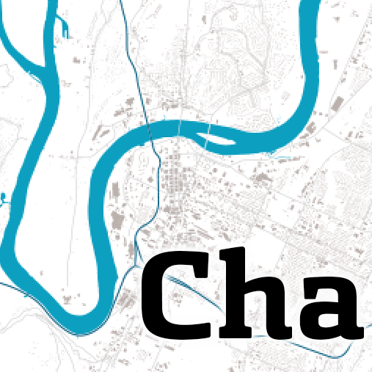

2nd Tuesdays 5:30-7:30pm

Slide 22

Thanks!
2015 Fellowship application ends July 15
codeforamerica.org/apply
jden.us/open-source-map-making

